Slide 1
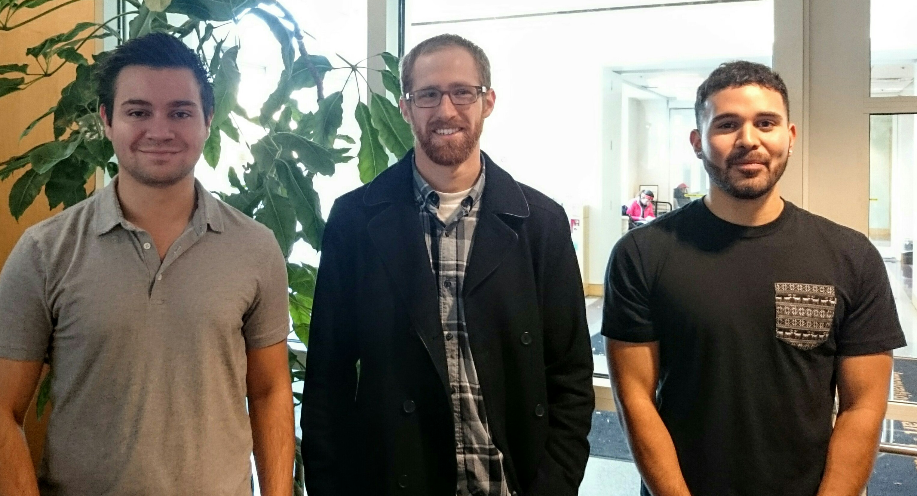
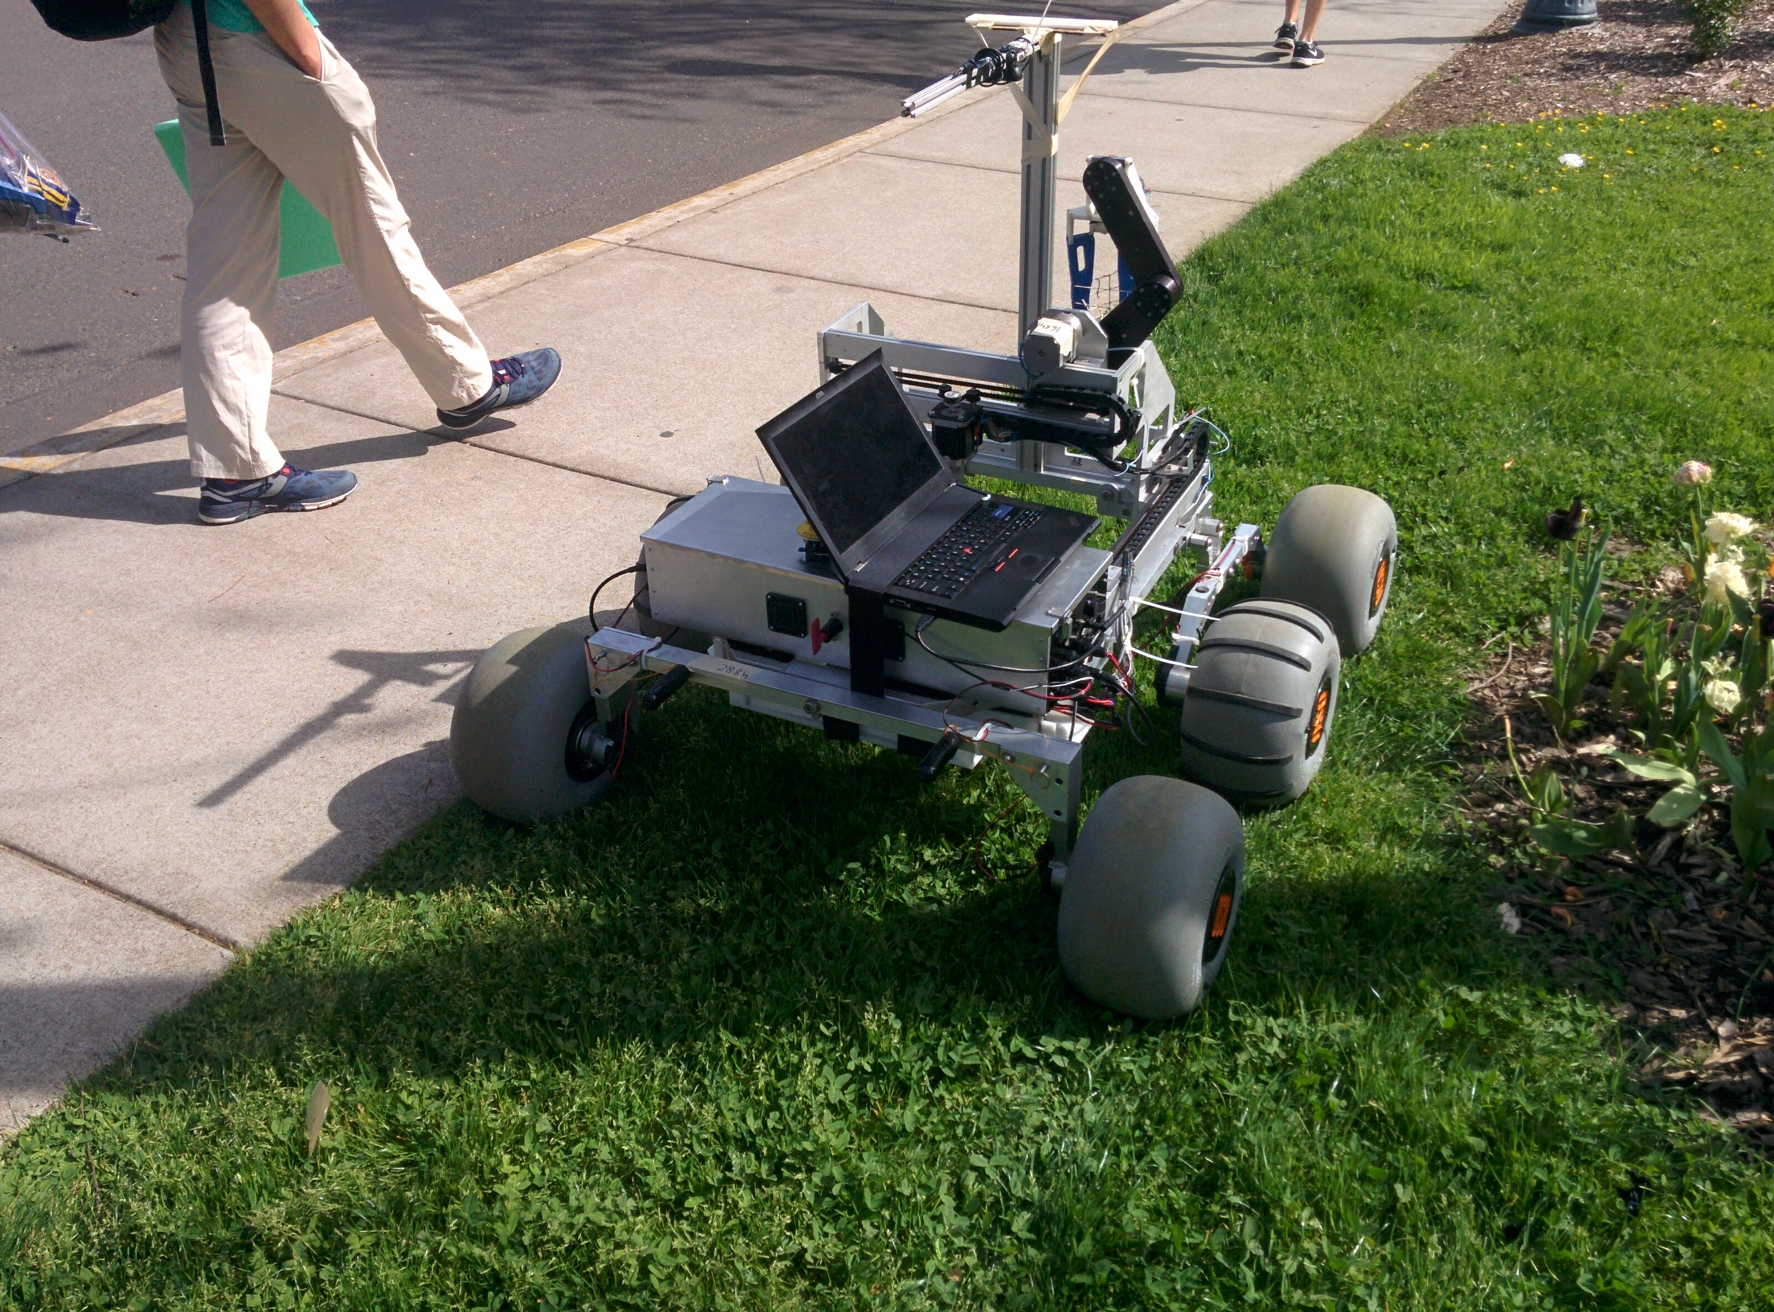

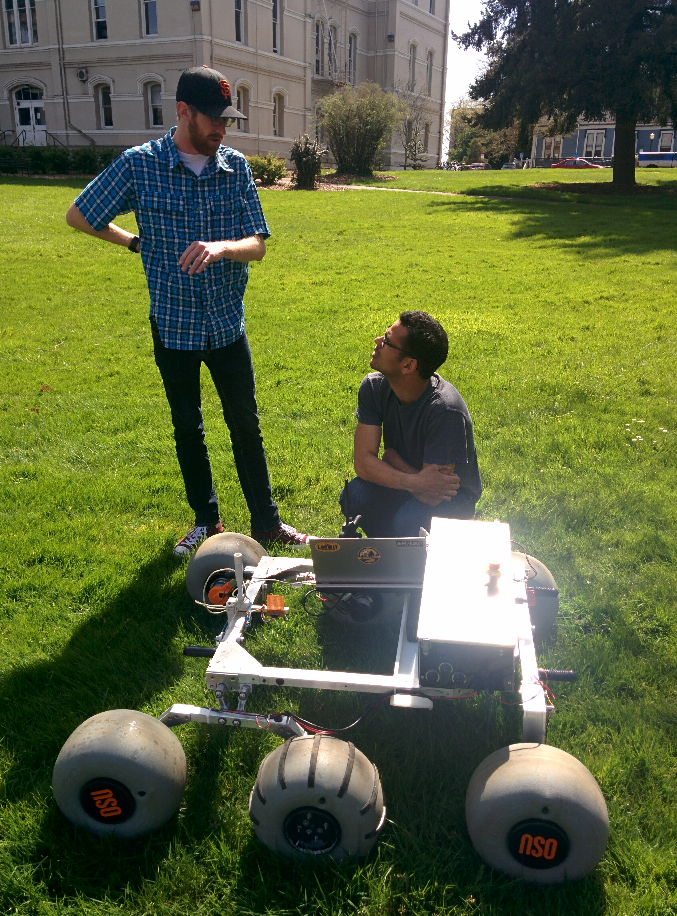
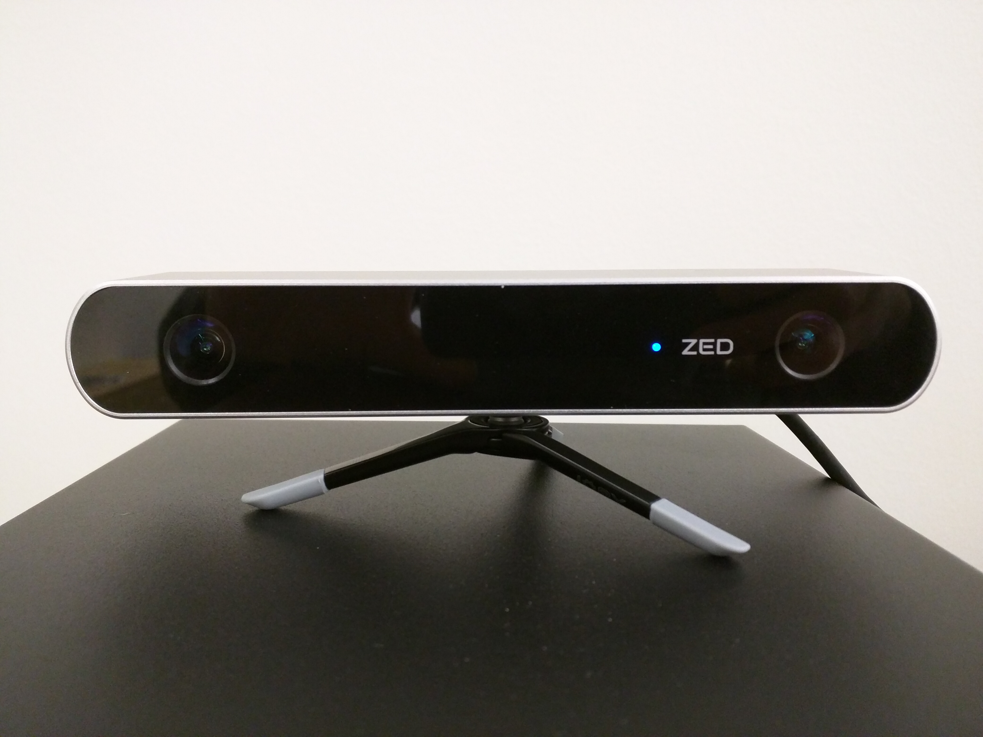
Rover Navigation and Avoidance NASA Centennial Sample Return Robot Challenge
Approach Taken
Stereo vision used as primary sensor input for navigation
Optical flow and wheel encoders used for odometry
Global and local path finding handled by packages within the ROS navigation stack
Competition map data used to develop routes of travel
PROJECT TEAM 21
Implementation
ZED Stereolabs camera was selected for depth sensing
A point cloud produced from the rectified ZED images aids in object avoidance and navigation
Radio beacon provides an estimated angle of the rovers position with respect to the base station
Checkerboard image provides secondary angle estimation and distance estimate from the base station
Odometry data and movement goals are used by the ROS navigation stack to plan paths
Sample recognition software provides position estimates for navigation toward detected objects
TEAM MEMBERS
Alex Arreguin
Jay Fenton
Ian Riemer
PROJECT ADVISOR
Billy Edwards
PROJECT SPONSOR
Robotics Club
Considered Solutions
Hardware
LIDAR – Laser range finding tool
Infrared/RGB cameras - Infrared depth measurement with an RGB camera, like the Xbox Kinect
Stereo Cameras - Two offset cameras to generate a depth image
Software
SLAM - Simultaneous Localization and Mapping
Dead Reckoning – Determining position by using a previous position data and estimates of velocity and direction
Pilotage – Navigation by position compared to a fixed location
The rover with arm installed, out for testing
Project Description
We developed the autonomous navigation system for the Oregon State University Mars Rover. The rover will compete in The Sample Return Robot Challenge, where it must navigate unknown terrain, avoid obstacles, and return back to the base station it started from. During navigation the rover will detect and retrieve samples. The navigation system integrates with the sample recognition software, developed by another rover capstone team.
Results
To compete in level 1 teams were required to submit a video demonstrating successful completion of the tasks required.
Sample collection and movement were demonstrated on April 6th
Members from the Rover Team will compete in level 1 in Massachusetts from June 6th -11th
To compete in level 2, level 1 must have been successfully completed. Level 2 takes place September 2nd - 5th.
The Challenge
Level 1 - Teams retrieve two known samples on a marked off section of a football field.
Level 2 - Teams retrieve samples of varied material and size in a large park. A topographic map is provided along with potential areas of interest. Samples have a point value associated with them which count towards a teams competition score.
The selected vision hardware, a ZED Stereolabs camera
Odometry testing and tuning

